Slide 1
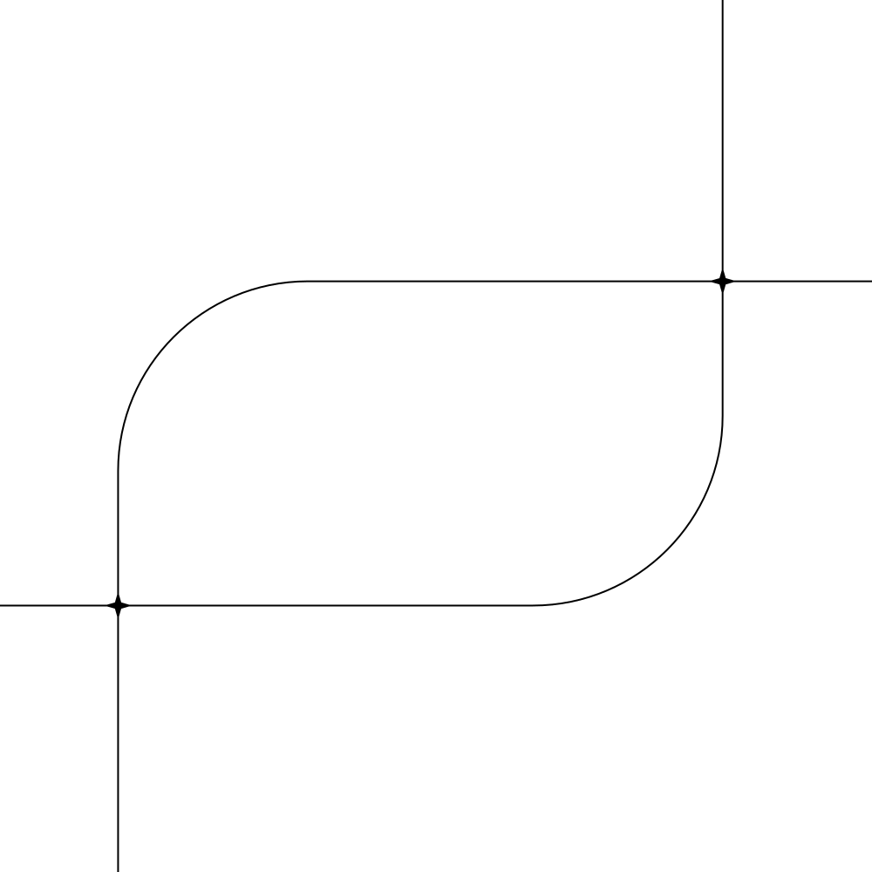
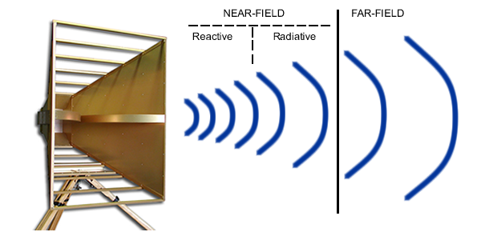
Near Field EMI Detector
Team Members
KASTHURIARACHCHI K.A.A.D (EG/2021/4605)
WEERASIRI G.M.I (EG/2021/4858)
WEERASOORIYA W.M.I (EG/2021/4859)

Slide 2
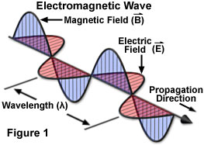
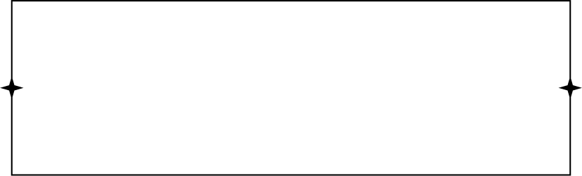
What is Near-Field and Far-Field?
Far Field
Region far from the antenna or source.
The electric field (E) and magnetic field (H) have roughly same magnitude
Near Field
Region close to the antenna or source.
One of the electric field and the magnetic field will dominante.
The dominant field depends on the characteristics of the source of emission.

Slide 3
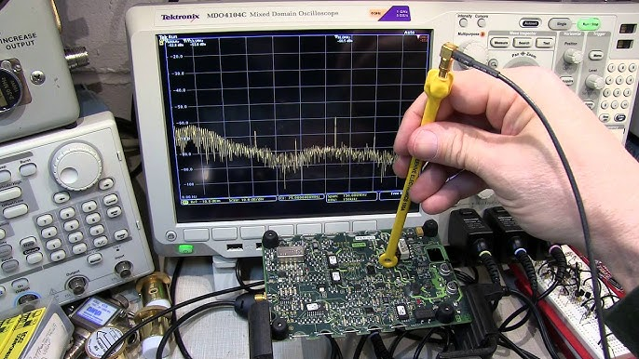
What are Near-Field Probes?
specialized sensors designed to measure electric (E-fields) and magnetic (H-fields) in the near-field region.
Used for detecting electromagnetic interference (EMI) and analyzing circuit behavior.
Types of Near-Field Probes
Electric Field (E-Field) Probes
Detects electric field strength.
Typically constructed using a small metal plate or antenna.
Requires a high-impedance circuit for accurate measurement.
2. Magnetic Field (H-Field) Probes
Detects magnetic field strength.
Constructed using a loop of wire or an inductor coil.

Slide 4
Project Overview
Objective
To design a cost-effective near-field EMI detector for detecting and displaying E and H fields separately.
Microcontroller-based measurement system (Arduino).
E and H fields sensed by dedicated probes.
Real-time display of field strengths.
Key Features

Slide 5
Relevance in Real-World Applications
Helps in Electromagnetic Compatibility (EMC) testing to identify and troubleshoot EMI sources in electronic devices.
Enables circuit design optimization by analyzing field distributions in PCBs and electronic components.
Facilitates debugging of consumer electronics, such as smartphones, laptops, and wearables, for EMI issues.
Ensures safety and performance of medical equipment like MRI machines and pacemakers.
Evaluates telecommunication systems by measuring field emissions and minimizing signal interference.

Slide 6
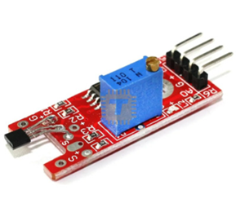
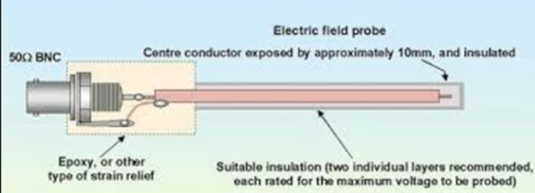
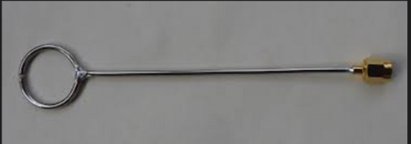
Components Needed
Magnetic Field Sensor (H-field Probe)
DIY option: Inductor coil or loop of wire (coaxial cable)
Pre-made option: Hall Effect sensor (for low-frequency magnetic fields)
2. Electric Field Sensor (E-field Probe):
DIY option: Antenna (coaxial cable)
3. Nano Board
4. NRF24L Wireless Transceiver Module –
5. Wires, connectors, and soldering tools

Slide 7


Thank You

